Slide 1

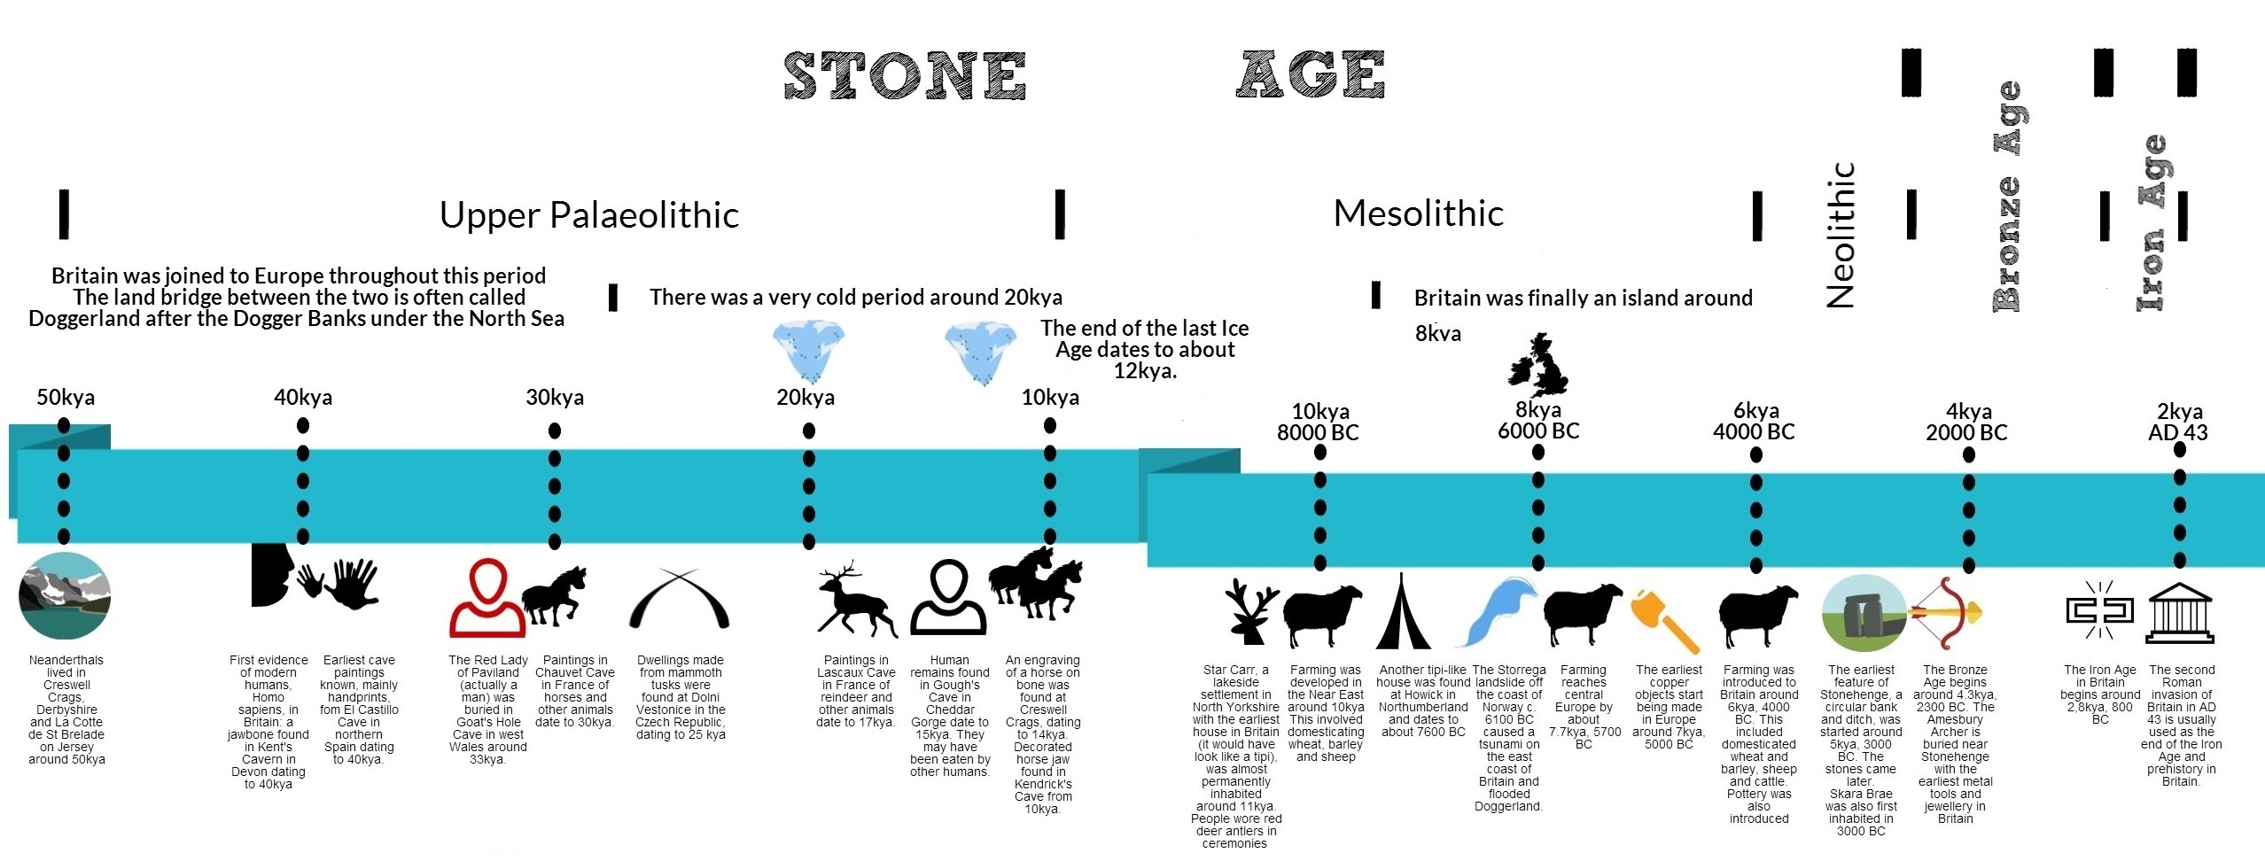



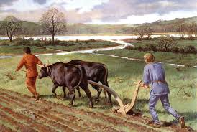
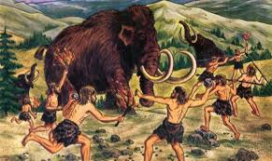
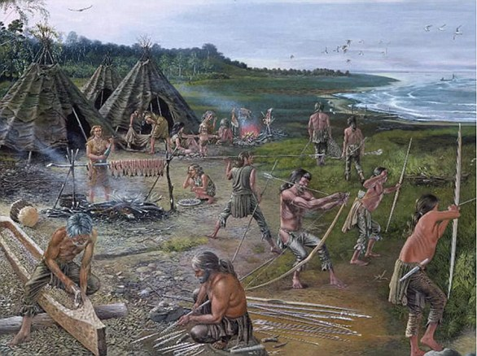


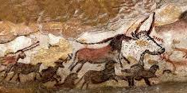


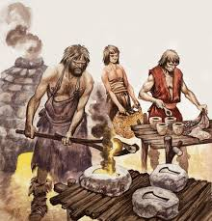

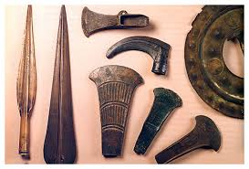

Y3
How do we know if we weren’t there?
History
Stone Age
1.
2. Primary sources are often considered the most credible in terms of providing evidence for your argument, as they give you direct evidence from the period of study. | 11. Iron took over from bronze as the most important metal.
 | 12. New farming techniques increased how much food could be produced and the population rose. | 13. Hunter-gathers had to catch or find everything that they wanted to eat, Early man hunted to survive, The Stone Age began around 2.6 million years ago and ended in approximately 2,300BC | 13. Hunter-gathers had to catch or find everything that they wanted to eat, Early man hunted to survive, The Stone Age began around 2.6 million years ago and ended in approximately 2,300BC
3. A timeline normally shows important events or periods in chronological order.
4. Relevant questions elicit specific responses.
5. An art historical period is a stage in the history where skills and media are choices that an artist has made to create a piece of work.
6. In the Mesolithic period, people began to develop tools to hunt and fish whereas these tools had developed drastically by the iron age to improve farming. | Art
 | 14. Practise involves doing something regularly in order to improve your ability at it. |  | 16. Medium refers to the type of material used by an artist to create their artwork.
7. Most historians agree that secondary sources are less reliable than primary sources due to the passage of time that has passed between the event and the creation of the source | 15. Evaluation is judging the quality and value of something.
8. Relevant questions support key understanding about a historical period. | DT
9. The Bronze Age began when people realised they could extract metal from rocks. | 17. Materials are suitable if they meet the demands of the product i.e. have suitable properties (e.g., does it need to be waterproof? Strong? Malleable?)
 | 18. Designing a product involves thinking about its purpose and ensuring it meets that purpose.
10. Bronze was important as it was used for weapons, tools and jewelry. | 19. Shaping is manipulating materials to change their form.
 | 20. Success can be measured by evaluating whether a product meets the demands of the intended audience and purpose i.e., meets all the design criteria.
Neolithic Era
(4,000 BCE –
2,300 BCE
Bronze Age
(2,300 BCE –
800 BCE
Iron Age
(800 BCE –
43 AD
Paleolithic Era
(2.6 million years ago – 10,000 BCE
Mesolithic Era
(10,000 BCE – 4,000 BCE

Slide 2











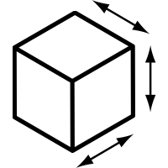

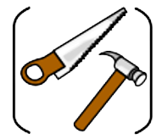


Year 3 Autumn Term How do we know if we weren’t there?
History Key Vocabulary
 | early man | The earliest forms of humankind, which existed over 2.6 million years ago.
 | settlement | A place where humans established a community.
 | currency | A system of money in a particular country or region.
 | adaptation | Changing to fit into your surrounding and environment.
 | prehistoric | A time before written records.
 | weaponry | A collection of weapons (arrows, spears, etc)
 | tribe | A group of people living together with a similar culture.
 | nomadic | Moving from place to place, without a permanent place for a home.
 | primary source | An original firsthand account of an event. Examples include letters, diaries, original photographs and artefacts.
 | secondary source | A secondhand account that interprets primary sources. Examples include books, newspaper articles and encyclopedias.
Art Key Vocabulary
 | proportion | The size of the objects compared to one another (a woolly mammoth is larger than a human).
 | dimension | The measurement of the length, height or depth.
 | control | Completing an action with it under control, with purpose.
DT Key Vocabulary
 | purpose | The reason something is done or designed.
 | design criteria | The goals a project must meet to be successful.

