Slide 1


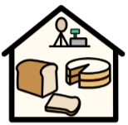
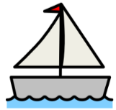


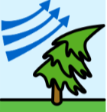
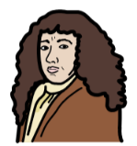
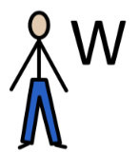
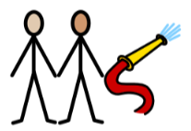
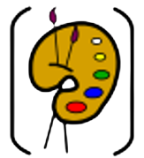
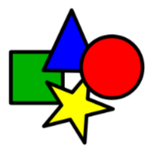
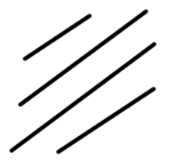
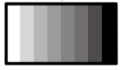
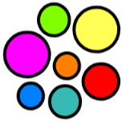


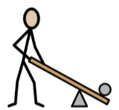

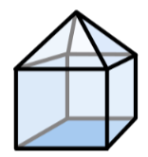
Y2
How has time changed the way we live?
History
The Great Fire of London (1666)
9. Samuel Pepys saw the fire firsthand and described it in his diary. | 10. The fire spread quickly through the wooden houses, lasting for 4 days. | 11. William Taswell saw the fire from afar and wrote about it. | 12. The Great Fire of London led to changes. The fire brigade was created to prevent and respond to fires.
Art
13. Colours can show emotions, like blue for sadness and yellow for cheerfulness. | 14. Art uses lines to create shapes. | 15. Different lines can show moods. | 16. Colours can be changed. Tint – add white Shade – add black Tone – add grey
Design and Technology
17. Wheels attach to an object using an axle so that it can move easily. | 18. Sliders move back and forth. | 19. Levers use pivots to change movement direction. | 20. To make a product strong and stable, use: strong structures right materials joins
2.. Sunday Morning
The fire started at a bakery on Pudding Lane.
4. Monday Morning
People climbed into boats on the River Thames.
6. Tuesday
St Paul’s Cathedral was destroyed.
1.. The Great Fire of London started September 2nd, 1666.
8. Wednesday
The fire was extinguished.
3. Sunday Evening
the fire raged west and burned through many houses.
5. Monday Evening
The fire spread close to the Tower of London and London Bridge.
7. Wednesday
The strong east wind dropped. The spread of the fire slowed down.

Slide 2








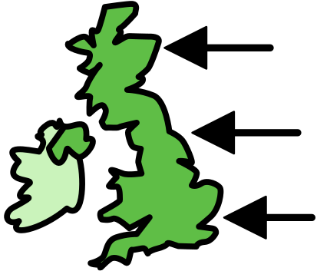



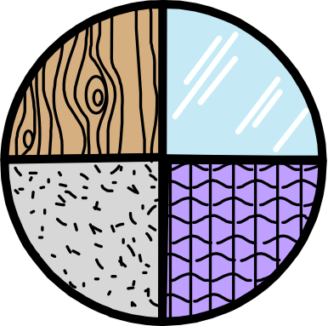



Year 2 Autumn Term How has time changed the way we live?
History Key Vocabulary
 | significant | Something of great importance.
 | historical sources | Information that we use to find out about the past (e.g. artefacts, documents, paintings, recordings, photographs).
 | primary source | Written by someone who witnessed the event.
 | secondary source | Written by someone who did not witness the event.
 | chronology | Things placed in order of time.
 | century | A period of 100 years.
 | impact | A marked effect or influence.
 | fire hook | A tool used to pull down houses.
 | national | Something that is common to a whole nation.
Art Key Vocabulary
 | tint | Changing a colour by adding white.
 | shade | Changing a colour by adding black.
 | tone | Changing a colour by adding grey.
Design and Technology Key Vocabulary
 | material | A substance from which things can be made.
 | tools | A device used to carry out a function.
 | axle | A rod that rotates the wheels and supports the weight of your vehicle.
 | construction | Building something, usually a large structure.

