Slide 1











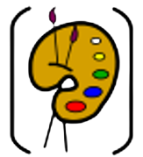
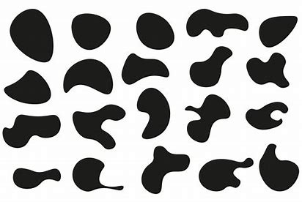








Y1
What has changed and what has stayed the same?
History
Toys and Technology (within living memory)
9. Alexander Bell invented the first telephone - 1876. | 10. Steve Jobs created Apple – 1976. | 11. Some toys have changed but some toys have stayed the same over time. | 12. Modern technology has changed how we play and live.
Art
13. A line can be straight or curved. It can be: horizontal vertical diagonal | 14. Shapes can be organic (irregular or imperfect). | 15. Geometric shapes have lines, curves or points. | 16. A pattern uses a repeated design or a motif, created using line, shape, colour or tone.
Design and Technology
17. Exploring focuses on what works well and not so well, to create new products | 18. A plan is talking about how you want to make your product. | 19. We follow a plan so the final product looks and functions in the planned way. | 20. Design criteria tells us what must be included in the design and product.
1920 | 1930 | 1940 | 1950 | 1960 | 1970 | 1980 | 1990 | 2000 | 2010 | 2020 | 2030
4. The past has already happened.
5. The present is happening now.
6. The future has not yet happened.
7. Artefacts give us information about the past.
8. We have things now that our parents and grandparents did not have.
9. I was born in 2019 or 2020.
1. Century = 100 years.
2. Decade = 10 years.
3. A year = 12 months.

Slide 2
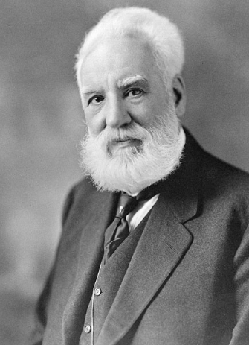
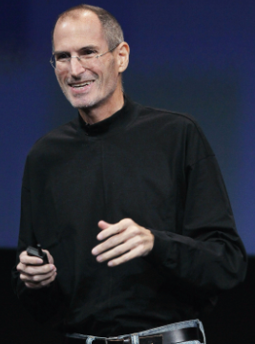
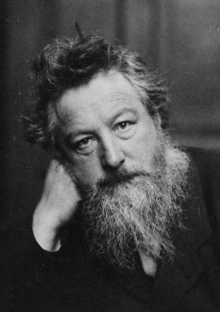




Year 1 Autumn Term
What has changed and what has stayed the same?
History
Art
Design and Technology
1920
1930
1940
1950
1960
1970
1980
1990
2000
2010
2020
2030
1. Century = 100 years.
2. Decade = 10 years.
3. A year = 12 months.
4. The past has
already happened.
5. The present is happening now.
6. The future has
not yet happened.
7. Artefacts give us information about the past.
8. We have things now that our parents and grandparents did not have.
9. I was born in 2019 or 2020.
Alexander Bell
10. He invented
the first
telephone
– 1876.
Steve Jobs
11. He created
Apple – 1976.
William Morris
12. He was an English
textile designer.
13. Some toys have changed but some toys
have stayed the same over time.
14. Modern technology has changed
how we play and live.
15. A line can be straight or curved. It can be:
- horizontal - vertical - diagonal
17. Geometric shapes have lines,
curves or points.
18. A pattern uses a repeated design or a motif, created using line, shape, colour or tone.
16. Shapes can be organic (irregular or imperfect).
19. Exploring focuses on what works well and not so well, to create new products
20. A plan is talking about how you want to make your product.
21. We follow a plan so the final product looks and functions in the planned
way.
22. Design criteria tells us what must be included in the design and
product.

Slide 3






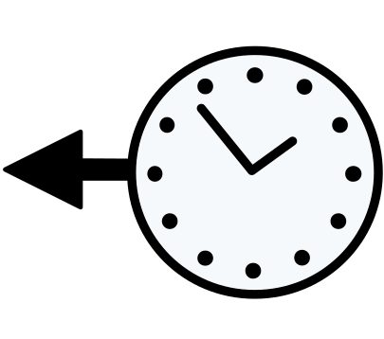

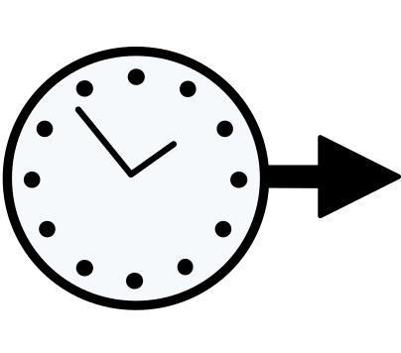

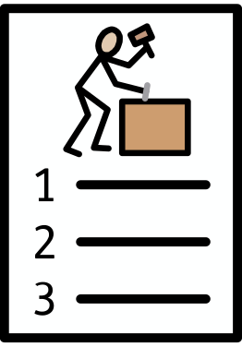

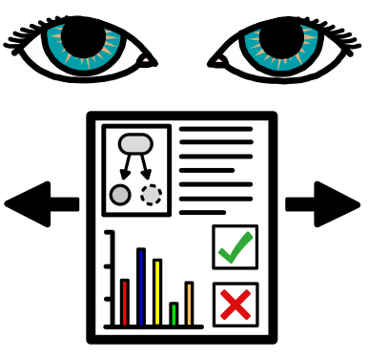
Year 1 Autumn Term What has changed and what has stayed the same?
History Key Vocabulary
 | artefact | Something of great importance.
 | fact | Something that is true.
 | fiction | Something that is not true.
 | chronological | Things placed in order of time.
 | decade | A period of 10 years.
 | century | A period of 100 years.
 | past | Something that has already happened.
 | present | Something that is happening now.
 | future | Something that hasn’t happened yet.
Art Key Vocabulary
 | line | A long, narrow marking.
 | geometric shape | A shape that has lines, curves and points.
 | organic shape | A shape that is free-flowing, irregular and asymmetrical. It resembles forms of nature.
Design and Technology Key Vocabulary
 | design | A drawing to show how a product is going to look and work.
 | plan | Thinking about how to do something before you do it.
 | purpose | The reason for creating something.
 | evaluate | Reflecting on how you have done something and if you could make it better.

